Slide 1
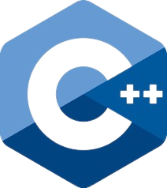
CapacityBay C++ COURSE DANIEL EMEKA - ILOZOR

Slide 2
#3 Variables AND INPUT

Slide 3
TABLE of contents
Variables
Keywords, Data Types and Sizes
Input in C++
Constant Variables and Swapping

Slide 4
01 VARIABLES

Slide 5
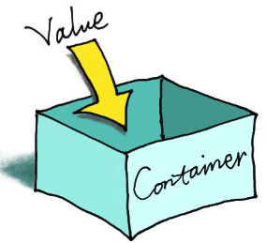
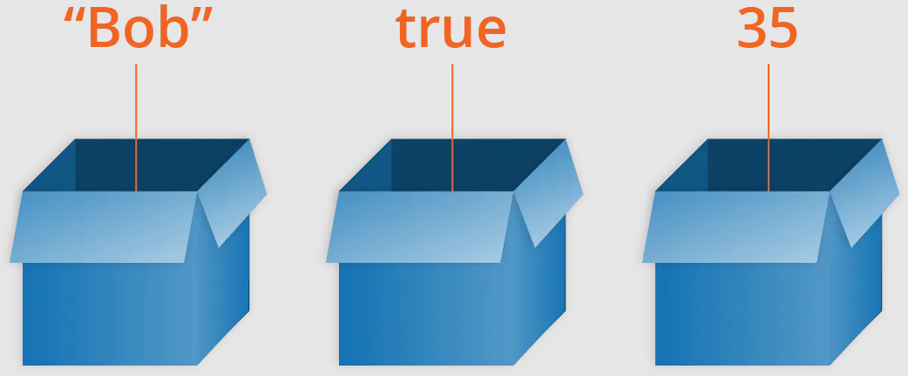
VARIABLES
A variable is like a named storage box that holds a value. It’s similar to variables in math equations that store things like numbers. Think of it as a container that can store different types of information, such as numbers, letters, or even more complex data. Just like you give a name to a box so you can find things easily, you give a name to a variable so you can refer to its value easily in your program. Variables have to be declared before they can be used.

Slide 6

Declaring a Variable
It’s easy to declare a variable using the format described in the first picture. As variables can store multiple data types, it is necessary to identify the datatype of variable we are going to declare. We must give our variables names. Multiple variables of the same type can also be declared in the same statement with a comma. Don’t forget the semicolon!

Slide 7



Initializing/ASSIGNING a Variable
This is quite easy.
You can initialize a variable with data to be stored during its declaration. You can also initialize variables of the same type in one line.
In most cases, you can change what is stored in a variable later on in the program.
Actually, we can also assign a variable to another variable’s contents.
In this context,
Variable name = new value (or other variable)
Means
Whatever is in variable name now becomes new value. i.e. if the variable is empty, it now contains new value. If it already had some other value previously, it is replaced with new value. The value/variable at the right hand side does not change!

Slide 8
Variable NAMING CONVENTIONS
Variable names are case-sensitive i.e. variable1 and Variable1 are different. Their names must also be unique.
No symbols should be used in variable names, except for the numbers, lowercase alphabetic characters, and uppercase alphabetic characters. However, the underscore (_) character is excluded from this scope and can be used in variable names.
Variable names must begin with a letter or an underscore (_) character, never with a number, symbol, or symbol.
The name of a variable can be up to 255 characters.
Space characters should not be used in variable names. However, the underscore (_) character can be used instead of a space.

Slide 9
02 KEYWORDS, DATA TYPES AND SIZES

Slide 10
KEYWORDS IN C++
Every language has certain keywords that give certain commands. Keywords in C++ are reserved words with special meanings and functionalities. They are part of the language itself and cannot be used for any other purpose. These keywords have specific roles and play a crucial role in C++ programming.

Slide 11
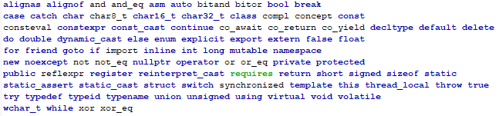
KEYWORDS IN C++
C++ Keywords are colored(as shown below) to identify they are reserved keywords for C++
The words that aren’t colored are actually not reserved for C++ and are instead used as alternatives to something else(e.g. a C++ symbol).

Slide 12
DATA TYPES
Datatypes define the type of data a variable can hold.
Just like different containers store different things, data types help store specific types of information.
There are numerous data types available in C++, but the most common ones you are sure to encounter are:
int, float, double, char, bool …

Slide 13
DATA SIZES
Data types are stored in computer memory. Each datatype has a specific size used to store one variable of that type. It is crucial to use the most memory efficient data type in order to not waste memory as computer memory is not infinite. Applications run better on lower memory usage, and if not done properly, the program you made might require too much memory than the system can allocate resulting in a crash.

Slide 14
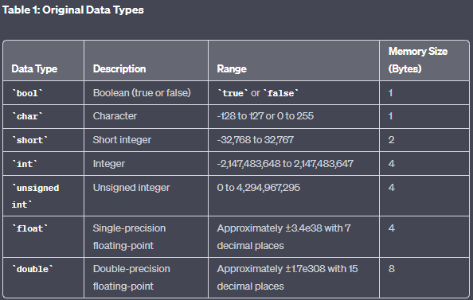
DATA TYPES

Slide 15
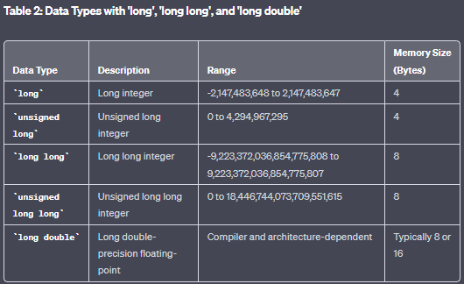
DATA TYPES(LONG)

Slide 16
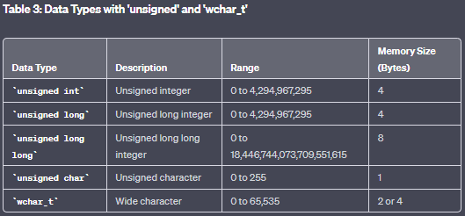
DATA TYPES(UNSIGNED)

Slide 17
03 INPUT IN C++

Slide 18
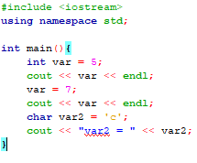

Printing Variables to CONSOLE
Cout is also used for printing variables
Cout << variable_name;

Slide 19
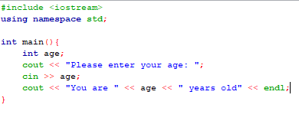
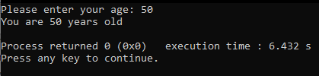
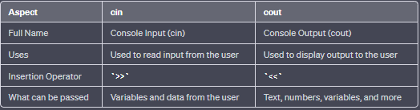
Reading input from user
We use CIN for that!

Slide 20
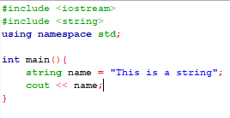
STRINGS
In programming, a string is a sequence of characters used to represent text. It can contain letters, numbers, symbols, and even spaces. Strings are commonly used to work with textual data, such as names, sentences, address, messages, and more. They are also a datatype for variables.
To use strings, you should include the string header file.
Upon further inspection though, it seems it works without using the string header file??? That’s because string is actually a really common data type used in C++ and it’s automatically included in iostream.
This is one of the conveniences provided by the C++ Standard Library to make programming easier and more efficient.

Slide 21
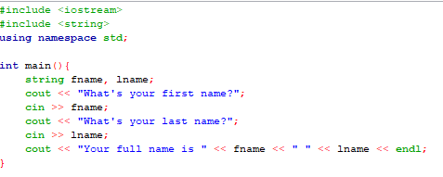
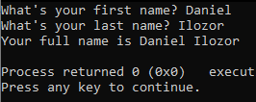
Reading THE USER’s NAME

Slide 22
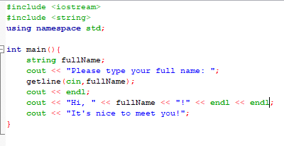
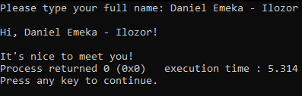
READING THE ENTIRE LINE IN A STRING
You may have noticed that a string can only read one word at a time with cin. To read an entire line, you need to use the getline().

Slide 23
04 constant VARIABLES and SWAPPING

Slide 24
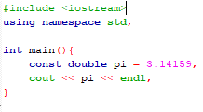
Constant variables
Sometimes you want to create a variable whose value cannot be changed once it is assigned. This is where constant variables come in.
A constant variable is a special type of variable whose value remains the same throughout a program's execution. Once you assign a value to a constant variable, you cannot change it later in the code.
In C++, you can declare a constant variable by using the const keyword before declaring the variable.
In this picture, it is clear PI will never change it’s value, so it’s good to use const in this case.

Slide 25
Why should I use CONST when possible?
Safety: Constant variables prevent accidental changes to critical values in your code, ensuring that important data remains constant throughout the program’s execution
Readability: Using constant variables makes your code more readable. If someone else encounters the const keyword for a variable in your code, they will know that variable will never change throughout the code.
Optimization: The compiler can actually optimize constant variables more effectively, potentially improving the performance of your program.

Slide 26

Swapping the contents of two variables
How to swap the contents of two variables?
Firstly, you can only do this for variables of the same type.
To do this, you can try relating this to real life.
Imagine you have two boxes, Box A and Box B(the variables).
Each box can hold one thing. Say the box ‘A’ holds a red ball, and the other a blue ball(the values).
The idea is to exchange the contents of these two boxes.

Slide 27

Swapping the contents of two variables
In real life you can just pick both balls and swap immediately… but we can’t directly do that in code…
The only skill we have in our current toolbox is assigning variables.
Remember, assigning a variable/value to a variable x is the same as replacing the contents of x with the assigned variable/value WITHOUT changing the contents of the assigned variable/value(right side).
How to use this?

Slide 28

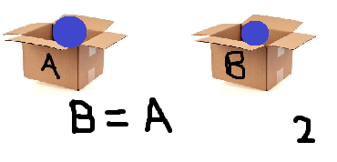
Swapping the contents of two variables
Directly doing this does not work: A = B
B = A
This is because the original information in box A is actually lost when assigning box B to A. So how can we remember the value in box A?

Slide 29
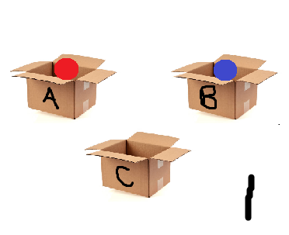
Swapping the contents of two variables
Let’s introduce a third box ‘C’. (A new variable)
We can use C to remember what was in A by assigning the ball in the box ‘A’ to box ‘C’ at the start. ie C = A;
Now, we can do what we did before, and at the end, we put the old value of A(which is currently in C) in the box B

Slide 30
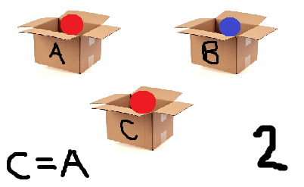
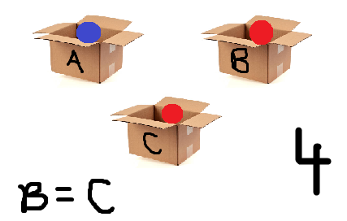
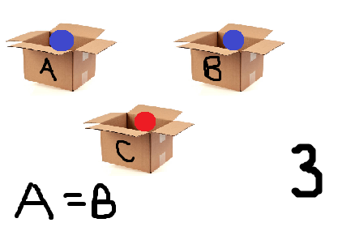
Swapping the contents of two variables
C = A (remember A)
A = B (A now contains blue)
B = C (B now contains red)

Slide 31
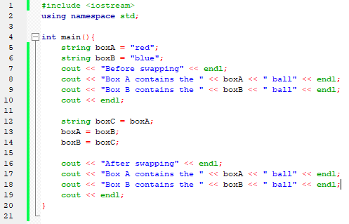
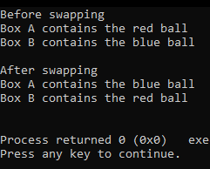
Swapping the contents of two variables

Slide 32
THANKS Q/A

